Slide 1
Help Note for a Homework Assignment on Observational Planning
Yoonsoo P. Bach

Slide 2
References
For professional observational proposal
How to write a (potentially successful) observing proposal (Jörn Wilms)
https://pulsar.sternwarte.uni-erlangen.de/black-hole/1stschool/coursematerial/proposals.pdf
A Sample NOAO Telescope Proposal
https://www.noao.edu/noaoprop/help/sample.pdf

Slide 3
Target Selection
In professional science, scientists select targets based on
scientific importance of the object/observation (Why should one wants to observe it?)
what kind of scientific progress we can expect from the observation (Why should the observatory support you?)
This part is called the scientific justification (SJ).
Summary of one SJ of our team :
Asteroid (162173) Ryugu is the mission target of JAXA's Hayabusa 2 mission. So far, people thought asteroids' surface is covered with fine (< 1 mm, down to few µm) dust particles. However, ~~~ (people debate about whether there are fine partcles or not, blah blah. Summarize all their logics succintly. Many reference papers go here).
Polarimetric observations so far have shown that it can estimate particle sizes on asteroids' surfaces. ~~~(description of the background theory, what and at which condition we have to observe for this theory to be applicable, previous studies which used similar techniques, …). The observational opportunaty comes in this October (2020). The next such chance will be in 2033, so this observation is essential.

Slide 4
Target Selection
In this homework, I don't want to ask you for such detailed SJ.
Just briefly describe
which target you selected (e.g., NGC xxxx),
what it is (globular cluster, variable star, planetary nebula, …),
what you want to measure (CMD, distance, morphology, …), and
what science you can obtain
comparing with stellar evolutional model & CMD, estimate the age of the cluster → history of evolution
light curve of AGN in Hα and B → get time lag → update R_{BLR}-L_{BLR} relation.
narrow-band photometry → calculate line ratio → kinematics of the supernova remnent
…
I don't ask you to find "new science". But you have to discuss "science". You may refer to any textbook, and select target which the textbook or reference paper used! Just review the science related to that object from textbooks, etc, and briefly describe them.
direct observables
scientific gain
https://arxiv.org/abs/1109.1848
https://www.aanda.org/articles/aa/pdf/2011/11/aa17325-11.pdf

Slide 5
SNR, sampling requirements
You have to be more quantitative.
If you use cepheid variable to get the distance, you have to know the cepheid's apparent magnitude and variable period.
mag
mag
average mag
("apparent mag")
time
time

Slide 6
SNR, sampling requirements
You have to be more quantitative.
If you use cepheid variable to get the distance, you have to know the cepheid's apparent magnitude and variable period.
mag
SNR too low
mag
Sampling rate too low
average mag
("apparent mag")
time
time

Slide 7
SNR, sampling requirements
You have to be more quantitative.
If you use cepheid variable to get the distance, you have to know the cepheid's apparent magnitude and variable period.
Based on available info, estimate SNR and sampling rate.
First, google the keywords ("cepheids in <galaxy name>", "cepheids luminosity period relation", …) and see research papers.
If google says the cepheid catalogued mag ~ 19 mag, with amplitude ± 0.7 mag, period of 30 days,
we need sampling rate of at least once a week (Nyquist says at least one successful sampling every 15 days but weather, etc…)
we need resolution better than ~ 0.2 mag to clearly see the light curve (SNR > 5).
Also, you may want the distance measurement error-bar as small as possible. If you want ± 10% error,
The mean mag of the star must have error < 0.1 mag (SNR * sqrt(N) ≳ 10)
The error in mean mag propagated through the luminosity-period relation must be smaller than 10%.
Using these information, you may estimate required SNR.

Slide 8
SNR, sampling requirements (Standard stars)
The reason you observe standard stars is to get the standardized mag of your object.
If you only need relative photometry, maybe there's no need to observe standard star at all.
but you need quantitative justification.
It is better to obtain SNR > 100 for standard stars.
Example: Each frame has SNR = 50 & You took 4 frames. Then combined SNR ~ sqrt(N)*SNR-per-frame = 100 (based on CLT).
Take as many standard star frame as possible, because the sky condition may vary.
If you found the sky condition significantly varied based on the analysis on the standard star frame, you may have to decide whether to discard all the data on that night.
Also, if the SNR of the standard star is not enough, you may be stuck in a situation that you cannot standardize the data at all…! This is a disaster, so taking standard star should be the first priority than taking your targets.

Slide 9
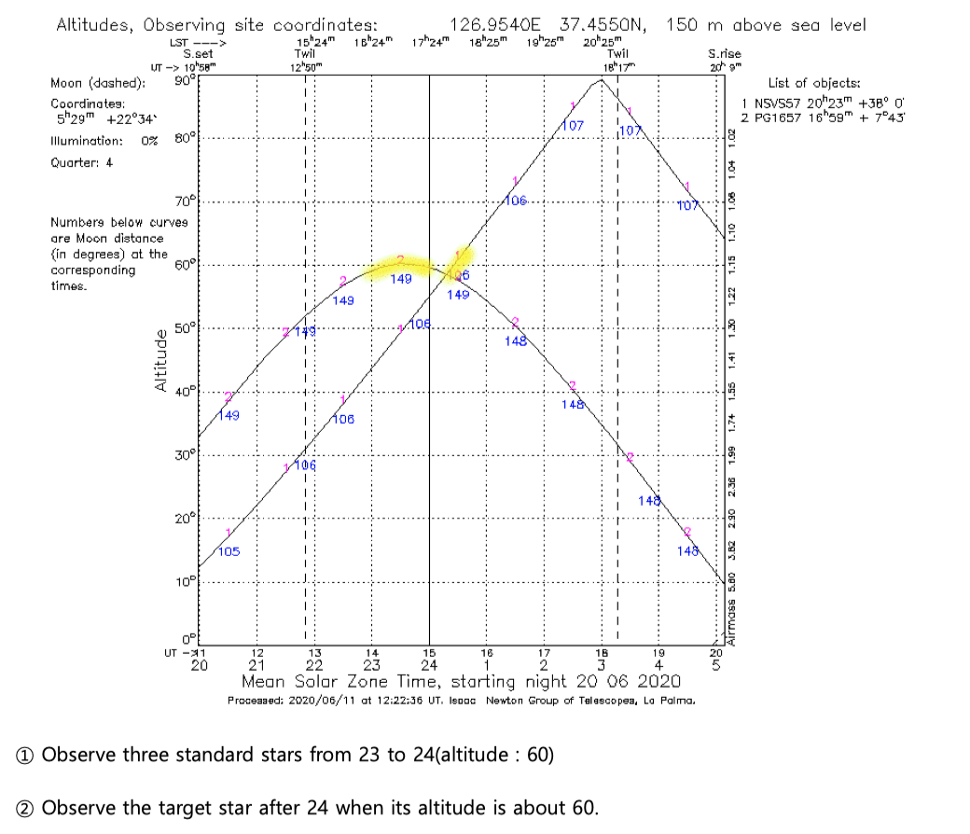
Observation Schedule
Not only just provide the time-altitude chart, but please describe in which order you will observe the object (and standard star, etc).
You must have considered airmass at least.
Student Chang, Yeonjin's

Slide 10
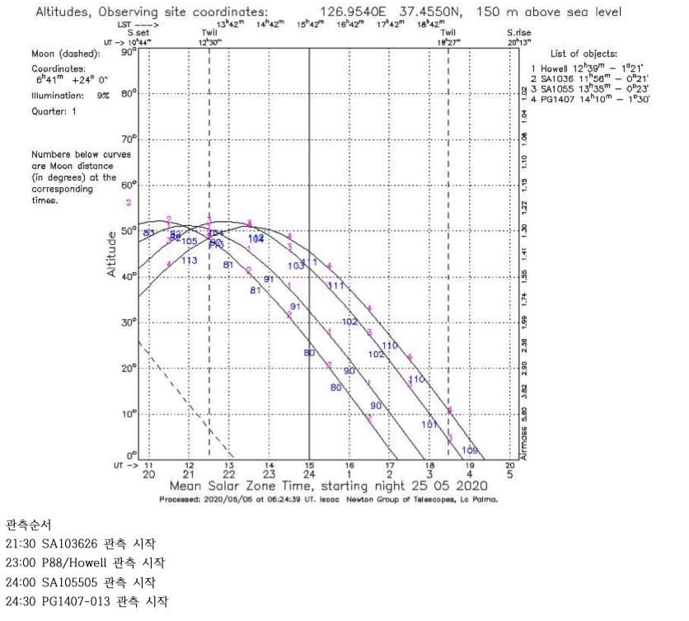
Observation Schedule
Not only just provide the time-altitude chart, but please describe in which order you will observe the object (and standard star, etc).
You must have considered airmass at least.
Student Kim, Jinjae's

Slide 11
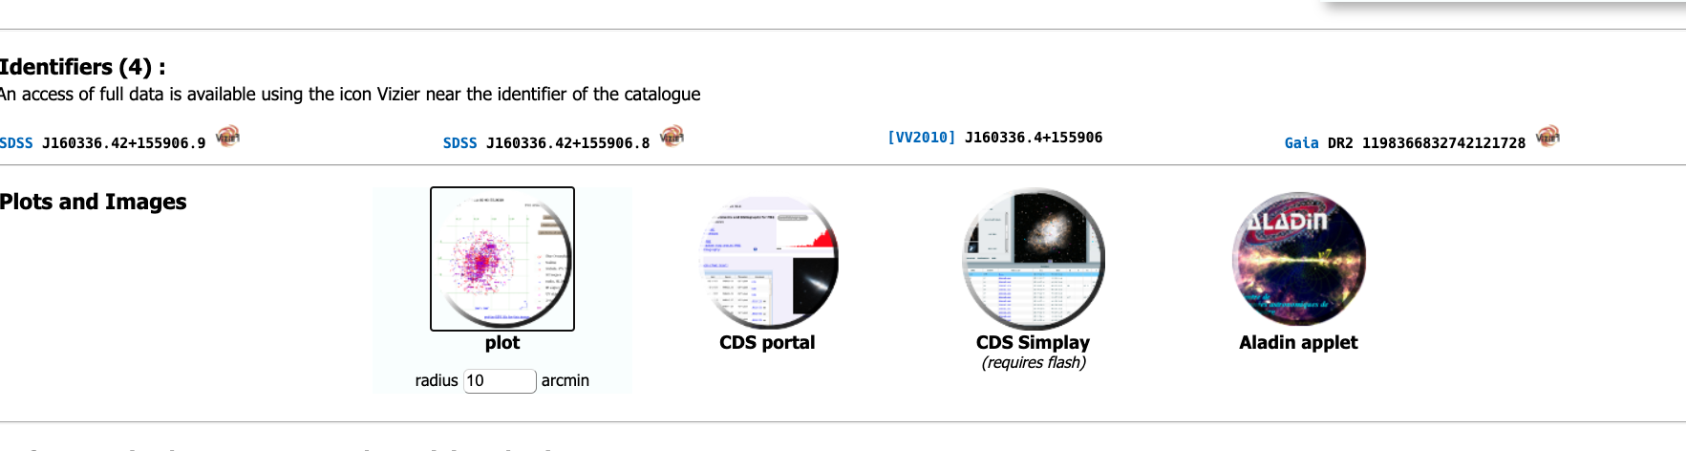
Star-Finding chart
Please check FOV carefully. Plus, consider which stars to use as guide stars.
Say you want to observe a faint quasar (http://simbad.u-strasbg.fr/simbad/sim-id?Ident=%405413300&Name=SDSS%20J160336.42%2b155906.8&submit=submit)
V-mag = 19, so almost no hope to spot it easily at first glance during the observation.
Go to "plot" from SIMBAD. Then "Get the list of objects". Or use "CDS portal".
Scrolling down, find which stars have bright magnitudes.

Slide 12
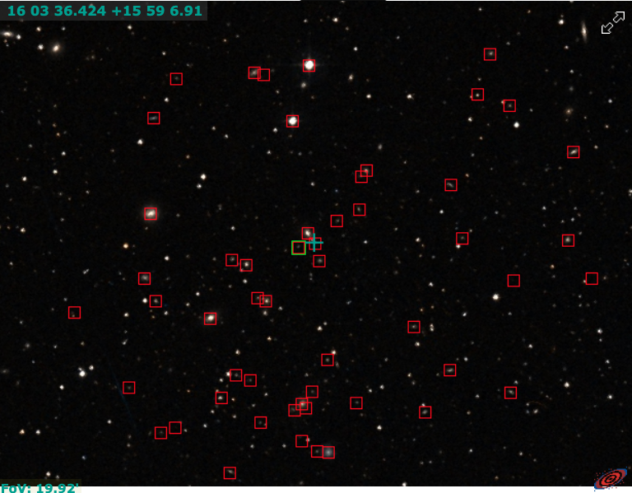
Star-Finding chart
naïve manual work….
http://simbad.u-strasbg.fr/simbad/sim-id?Ident=%406559617&Name=TYC%201503-317-1&submit=submit
V = 11.11
http://simbad.u-strasbg.fr/simbad/sim-id?Ident=%406559598&Name=TYC%201503-53-1&submit=submit
V = 11.88
http://simbad.u-strasbg.fr/simbad/sim-id?Ident=%402743724&Name=2MASX%20J16035802%2b1600022&submit=submit
r = 14.12

Slide 13
Star-Finding chart
You may use python.
https://github.com/ysBach/ysobsplanpy
%config InlineBackend.figure_format = 'retina'
from matplotlib import pyplot as plt
from matplotlib import rcParams
from ysobsplanpy import GuideStars
# We need to do it in a separate cell. See:
# https://github.com/jupyter/notebook/issues/3385
plt.style.use('default')
rcParams.update({'font.size':12})
# a random object SDSS J160336.42+155906.8 -- Quasar
g = GuideStars(ra=240.90177, dec=15.985262, radius=0.3, unit='deg')
g.query(mag_cut=13)
fig, axs = plt.subplots(1, 1, figsize=(7, 7),
sharex=False, sharey=False, gridspec_kw=None)
# Try g.quickplot? and change parameters as you like.
g.quickplot(axs, num_show_mag=5, fov_size=21, unit='arcmin')
plt.tight_layout()
fig.align_ylabels(axs)
fig.align_xlabels(axs)
plt.show()
see Table 3 of the following paper to understand the columns in g.queried
https://iopscience.iop.org/article/10.1088/0004-6256/136/2/735/pdf

Slide 14
Star-Finding chart
Draw some pattern which you will use for finding your object:
You may use python.
https://github.com/ysBach/ysobsplanpy
%config InlineBackend.figure_format = 'retina'
from matplotlib import pyplot as plt
from matplotlib import rcParams
from ysobsplanpy import GuideStars
# We need to do it in a separate cell. See:
# https://github.com/jupyter/notebook/issues/3385
plt.style.use('default')
rcParams.update({'font.size':12})
# a random object SDSS J160336.42+155906.8 -- Quasar
g = GuideStars(ra=240.90177, dec=15.985262, radius=0.3, unit='deg')
g.query(mag_cut=13)
fig, axs = plt.subplots(1, 1, figsize=(7, 7),
sharex=False, sharey=False, gridspec_kw=None)
# Try g.quickplot? and change parameters as you like.
g.quickplot(axs, num_show_mag=5, fov_size=21, unit='arcmin')
plt.tight_layout()
fig.align_ylabels(axs)
fig.align_xlabels(axs)
plt.show()
see Table 3 of the following paper to understand the columns in g.queried
https://iopscience.iop.org/article/10.1088/0004-6256/136/2/735/pdf

